Slide 1
DecisionTree_score
Test_size = 0.1

Slide 2
Linear Regression_score
Test_size = 0.1

Slide 3
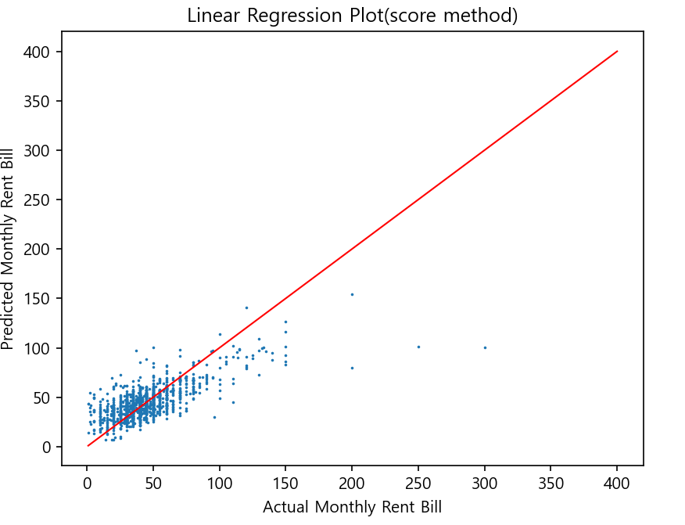

Slide 4
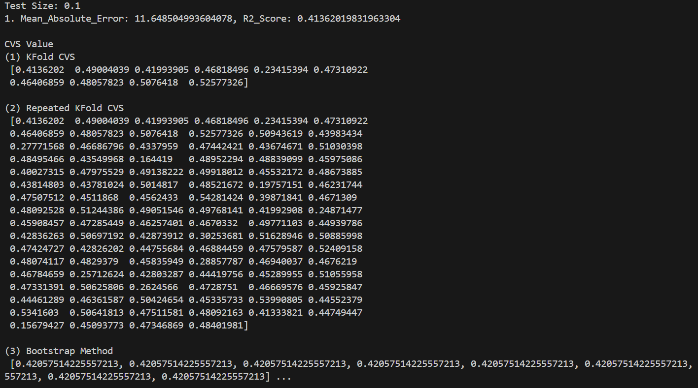

Slide 5
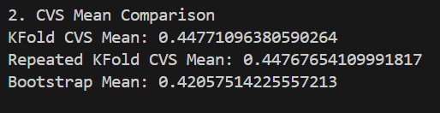

Slide 6
Linear Regression
Test_size = 0.2

Slide 7
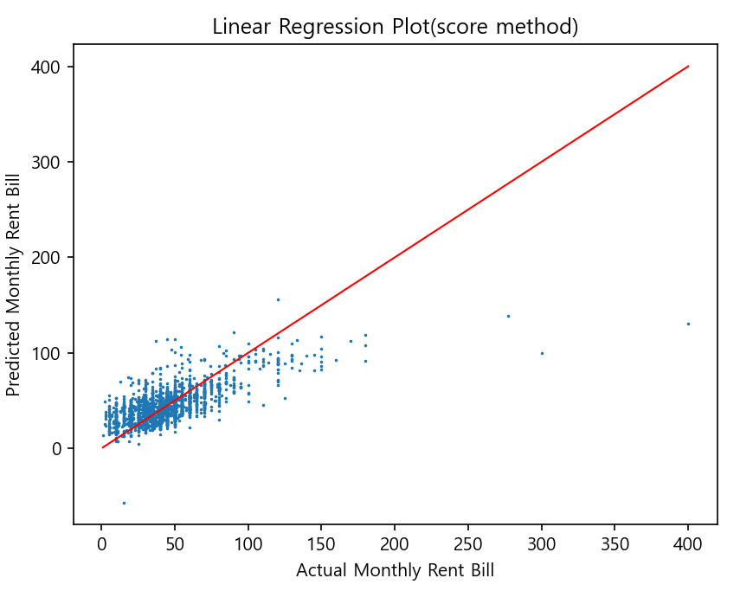

Slide 8
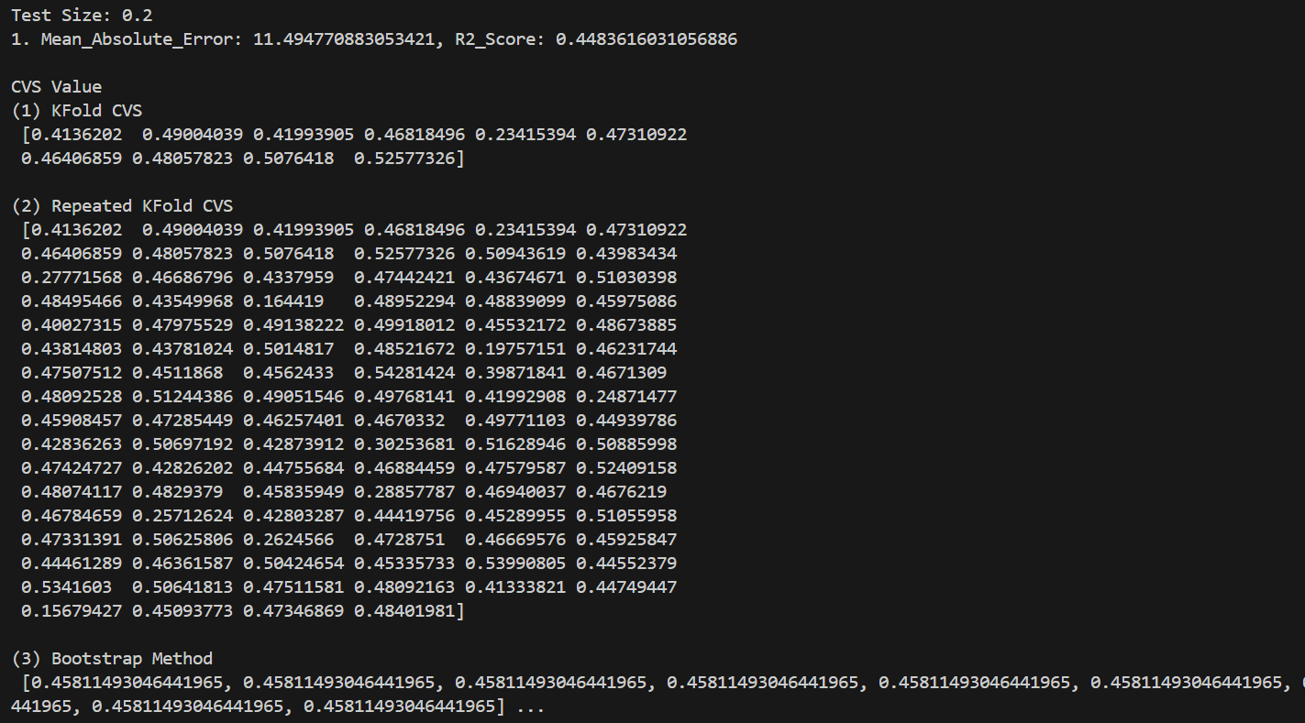

Slide 9
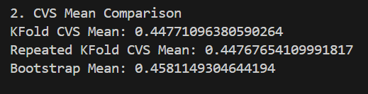

Slide 10
Linear Regression
Test_size = 0.3

Slide 11
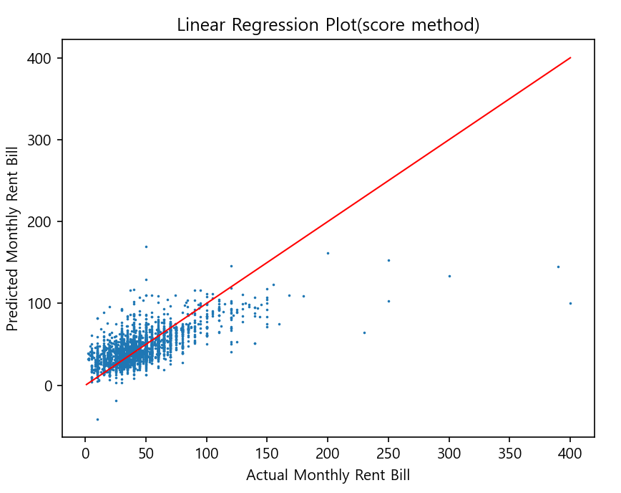

Slide 12
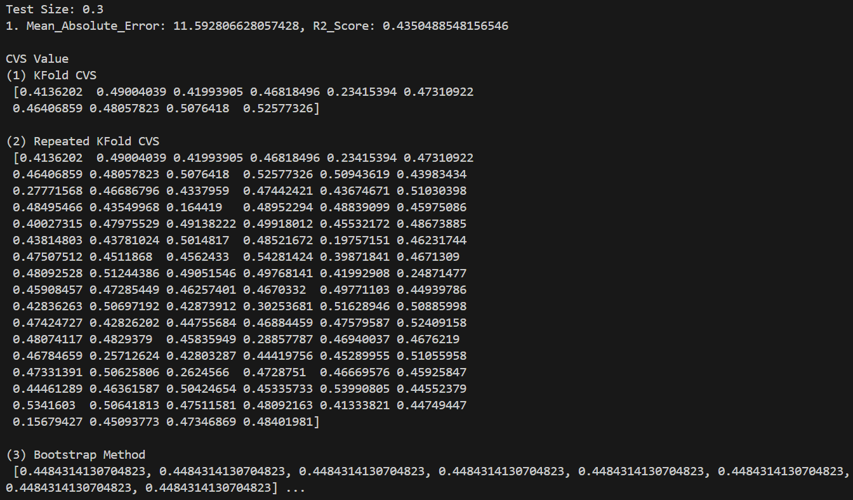

Slide 13
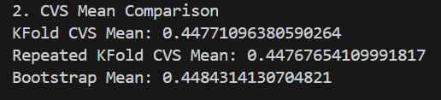

Slide 14
Linear Regression
Test_size = 0.4

Slide 15
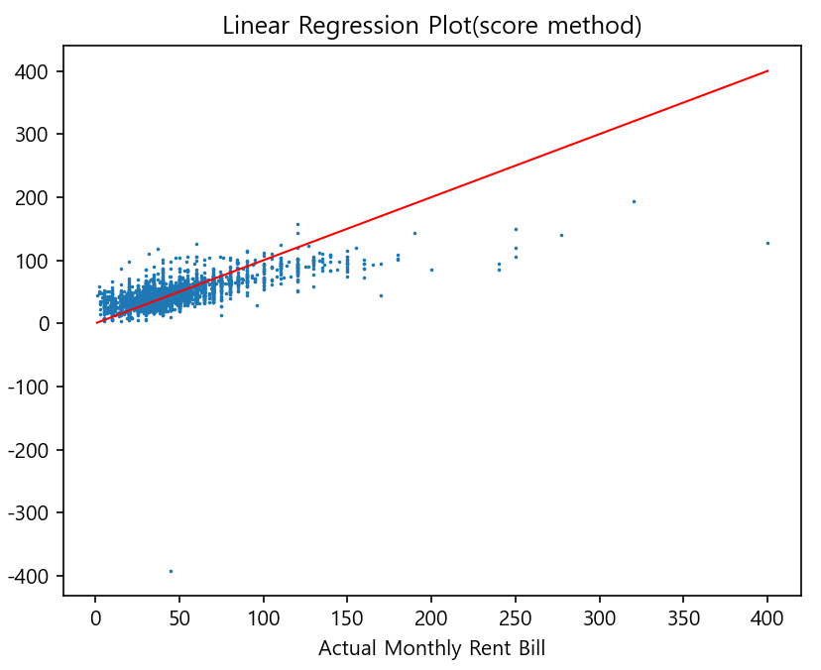

Slide 16


Slide 17
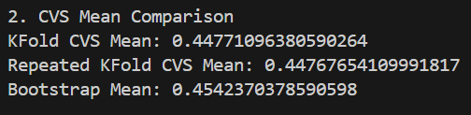

Slide 18
Linear Regression
Test_size = 0.5

Slide 19
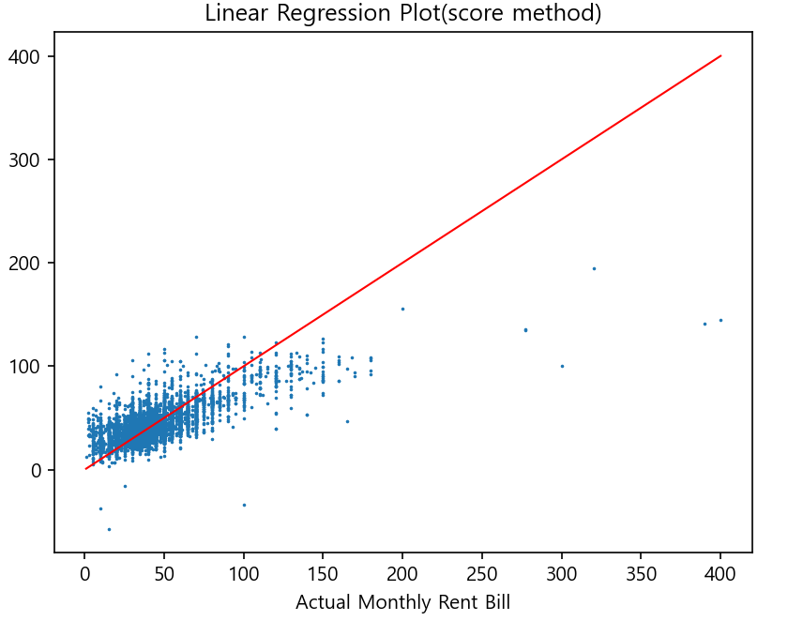

Slide 20


Slide 21
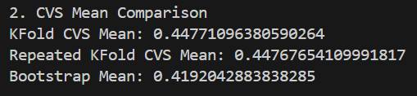

Slide 22
Linear Regression_one-hot
Test_size = 0.1

Slide 23
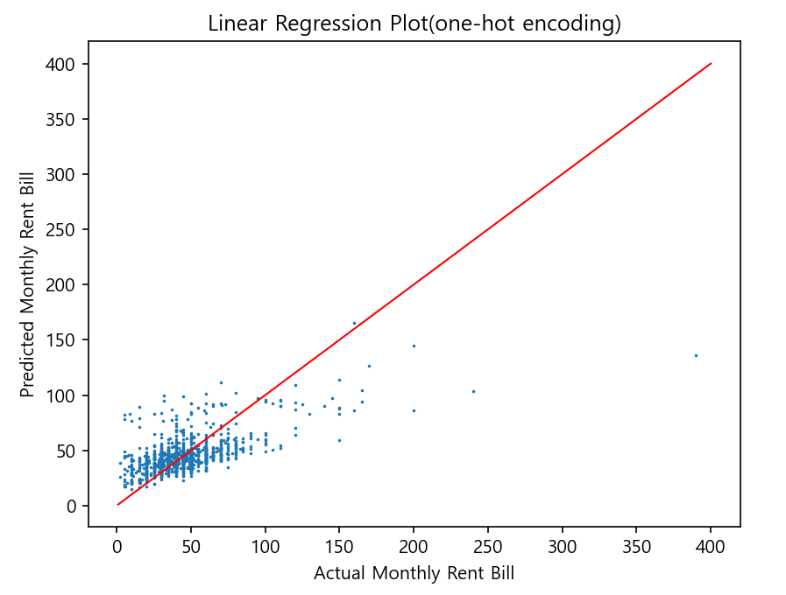

Slide 24
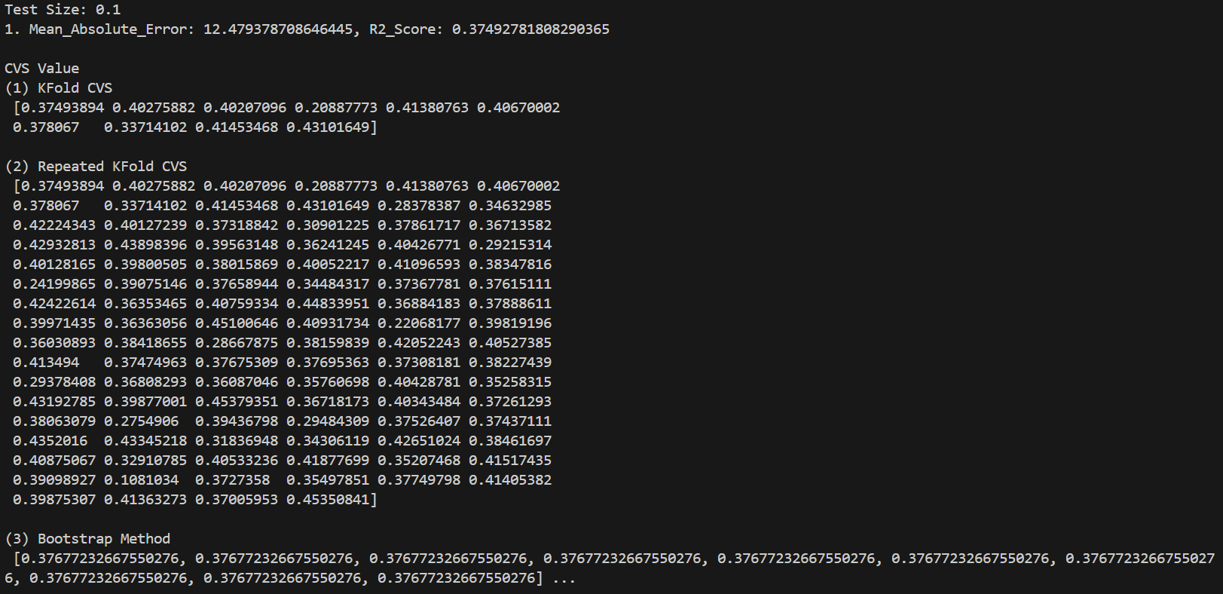

Slide 25
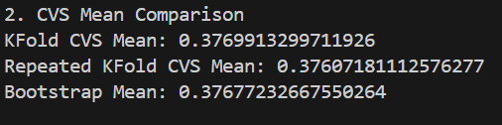

Slide 26
Linear Regression_one-hot
Test_size = 0.2

Slide 27
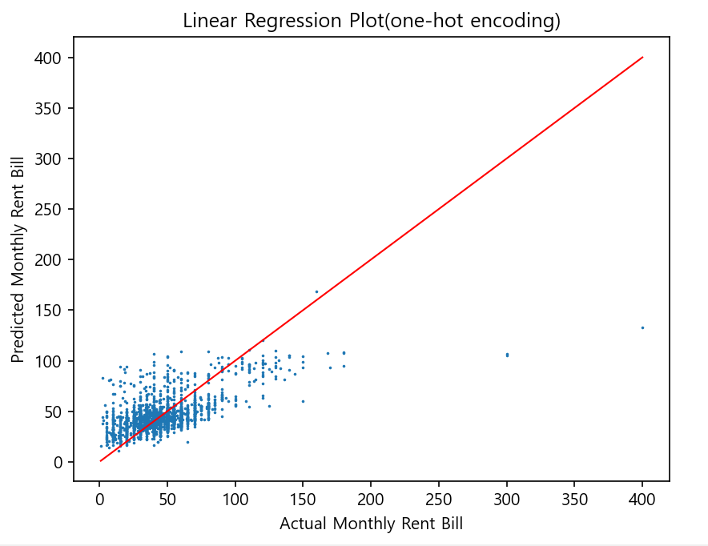

Slide 28


Slide 29
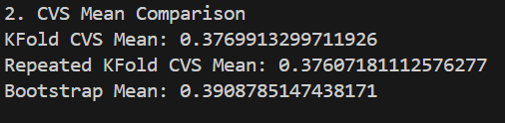

Slide 30
Linear Regression_one-hot
Test_size = 0.3

Slide 32
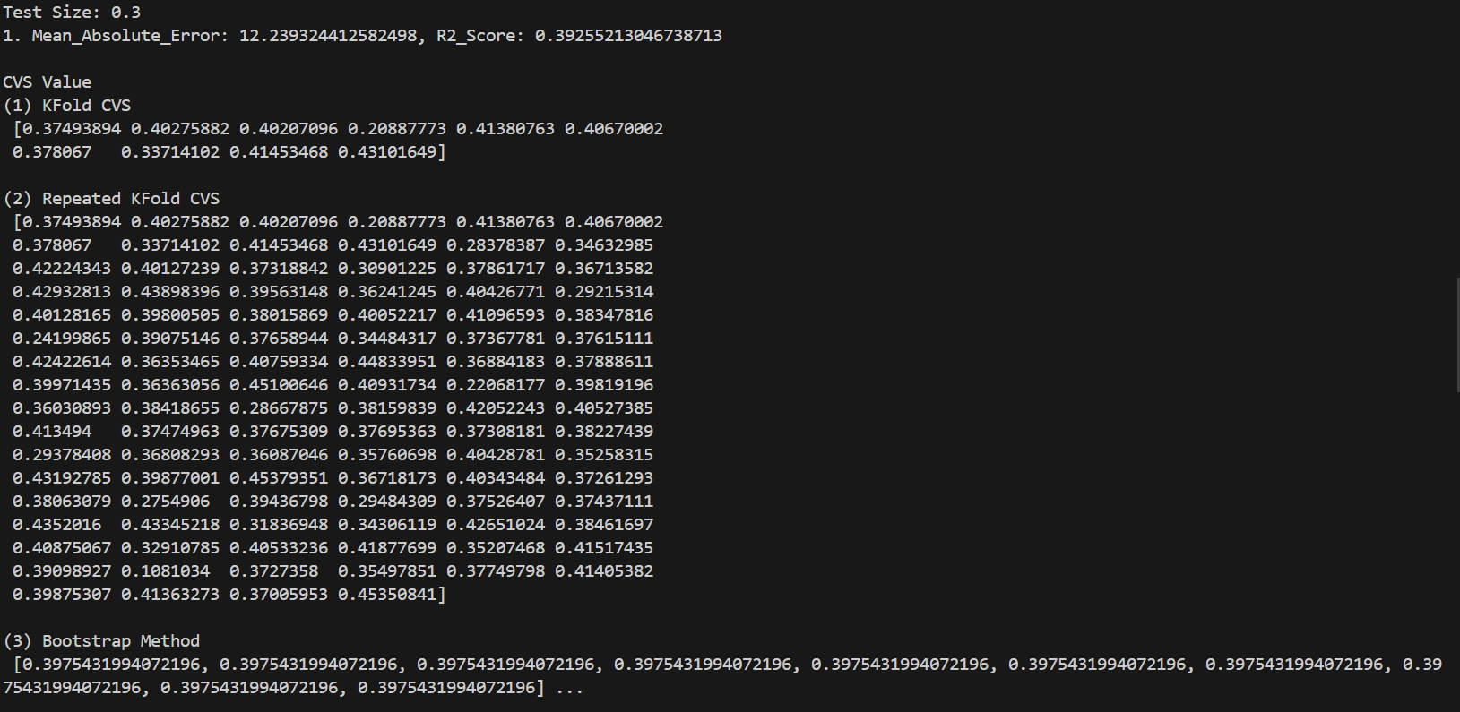

Slide 33
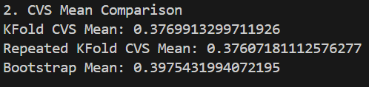

Slide 34
Linear Regression_one-hot
Test_size = 0.4

Slide 35
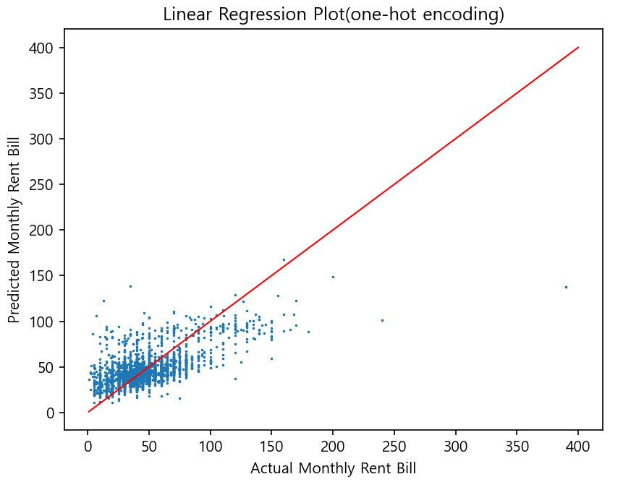

Slide 36
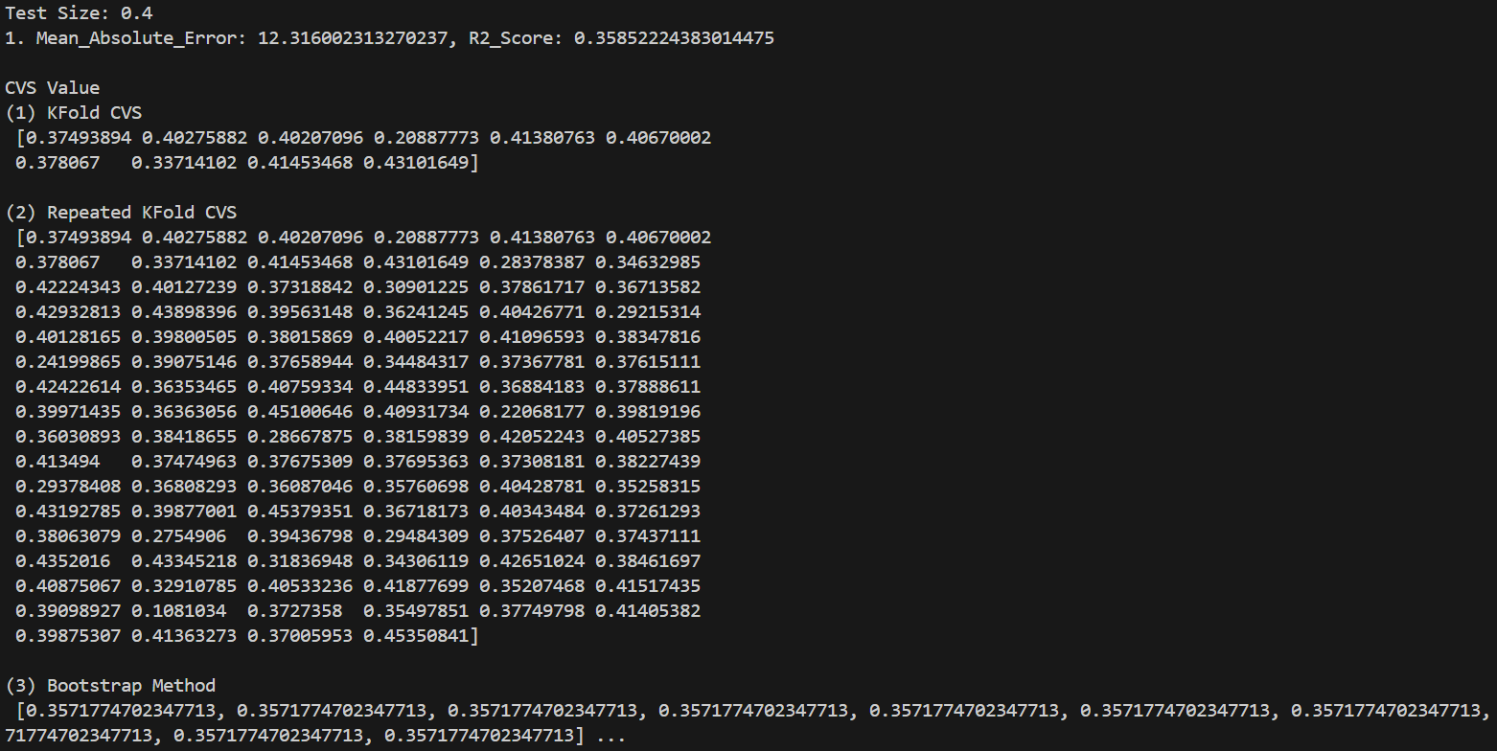

Slide 37
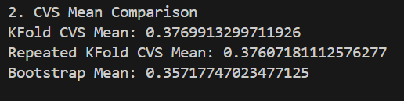

Slide 38
Linear Regression_one-hot
Test_size = 0.5

Slide 39
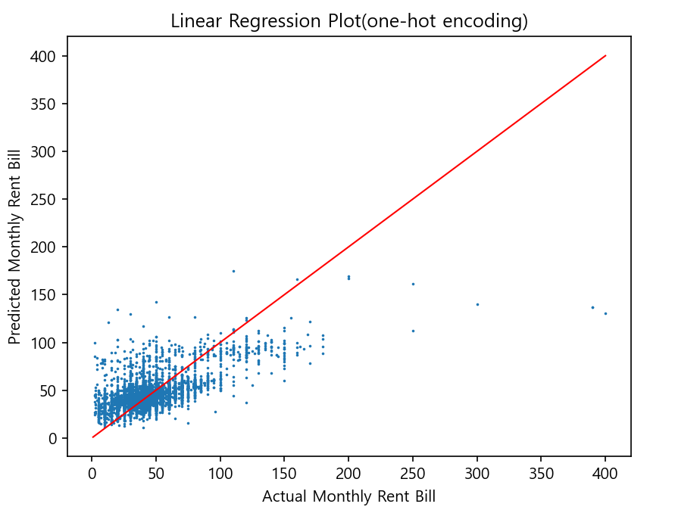

Slide 40
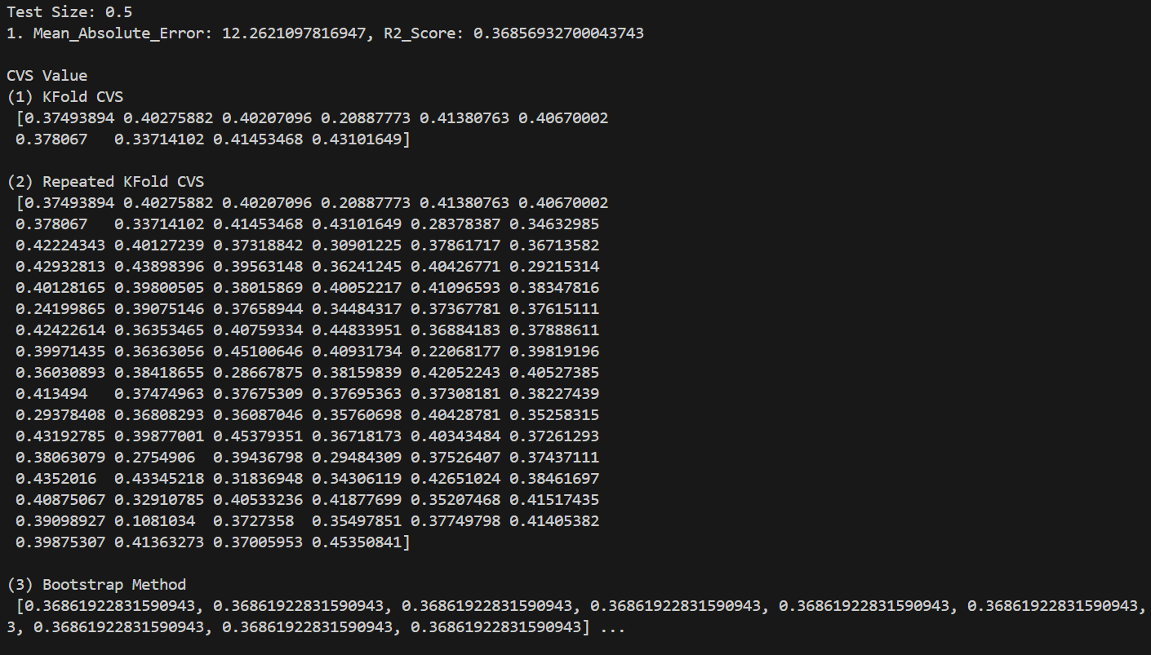

Slide 41
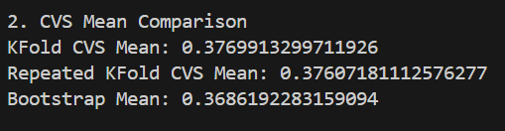

Slide 42
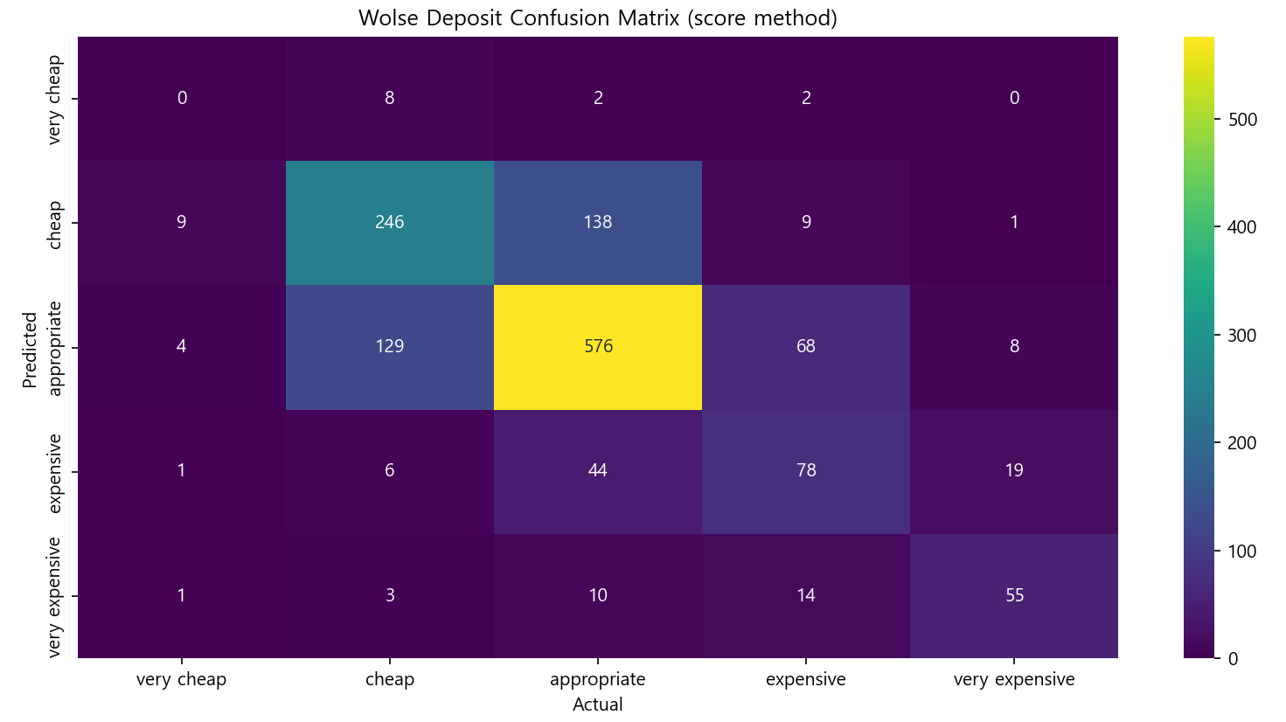

Slide 43
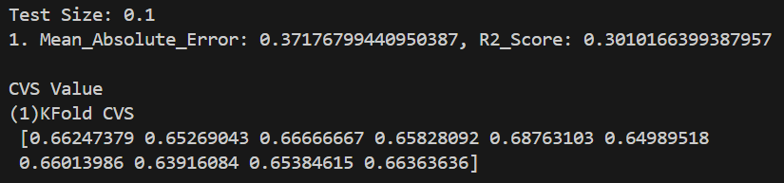

Slide 44
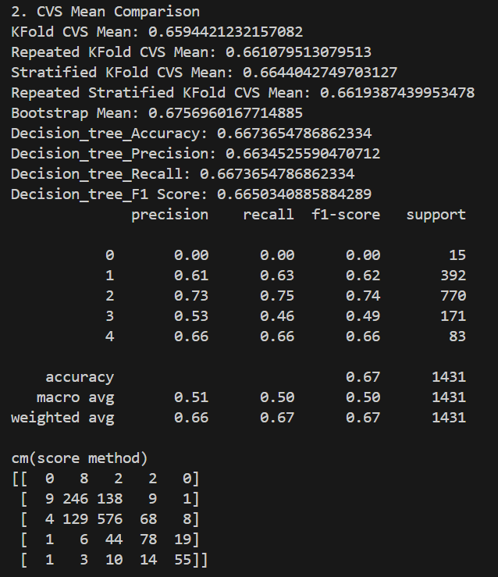

Slide 45
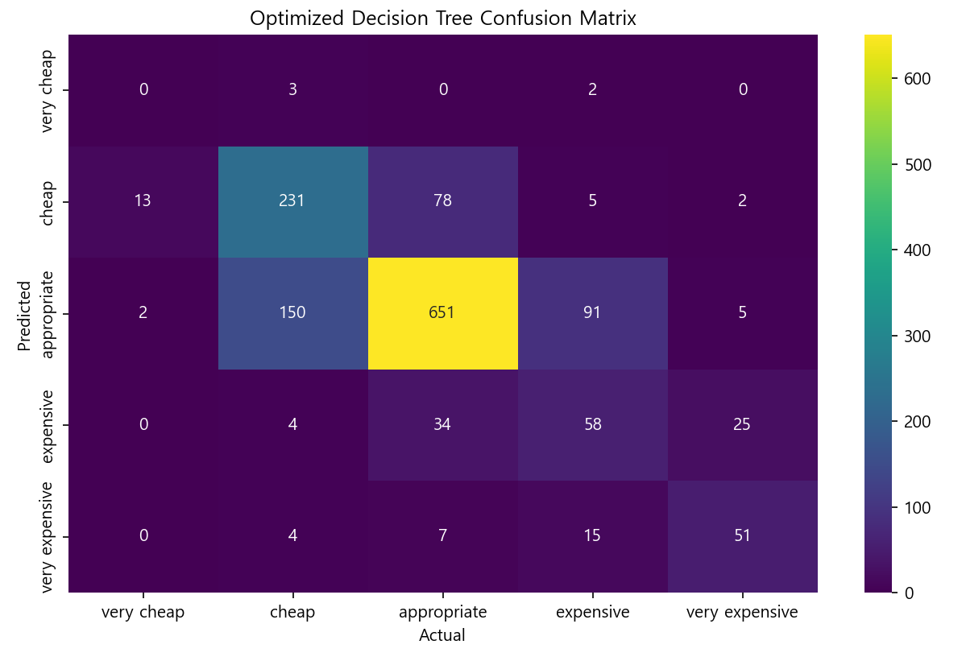

Slide 46
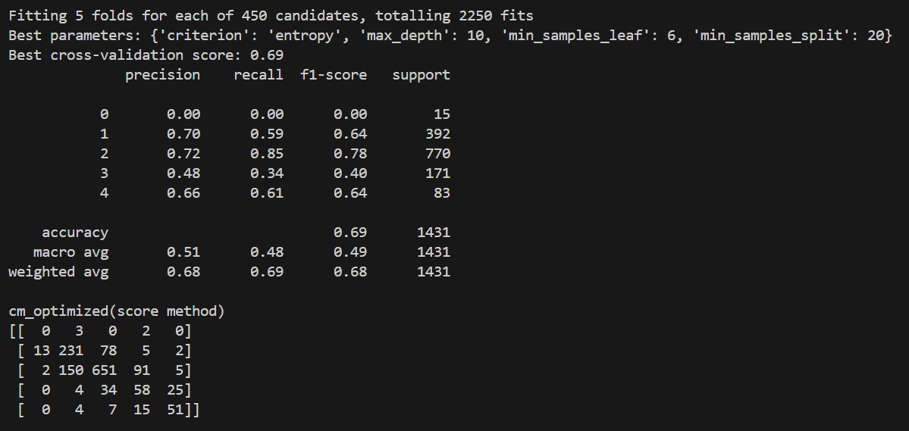

Slide 47
DecisionTree_score
Test_size = 0.2

Slide 48
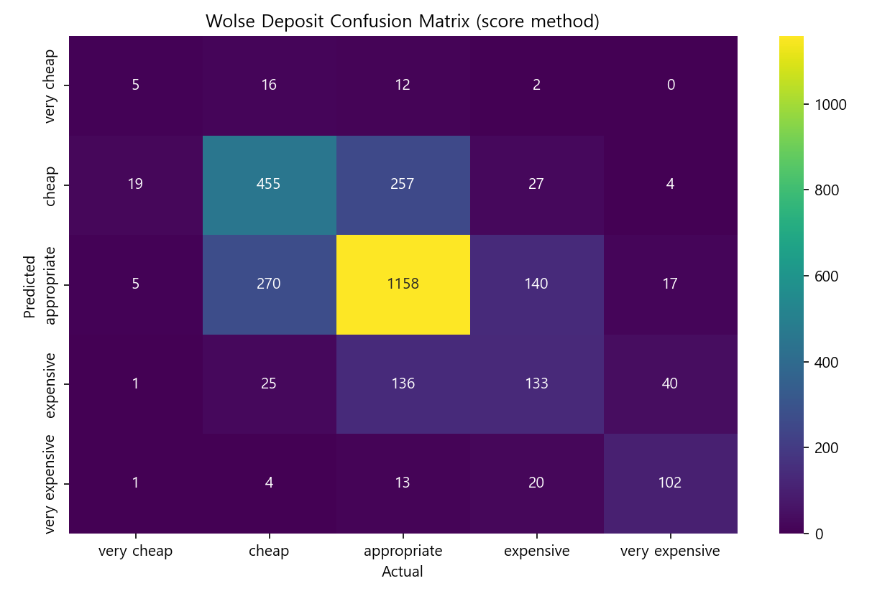

Slide 49
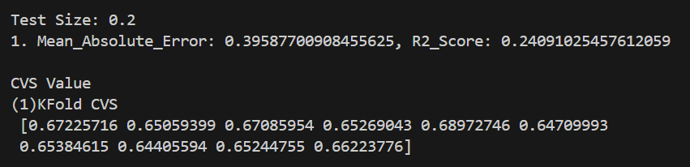

Slide 50
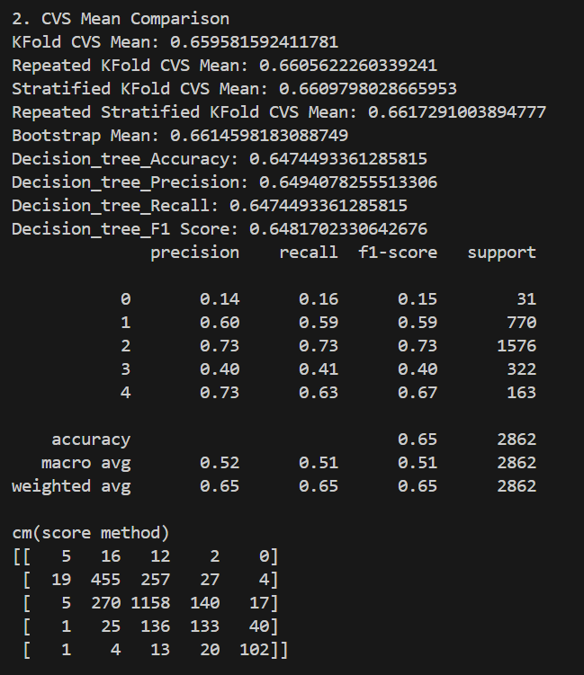

Slide 51
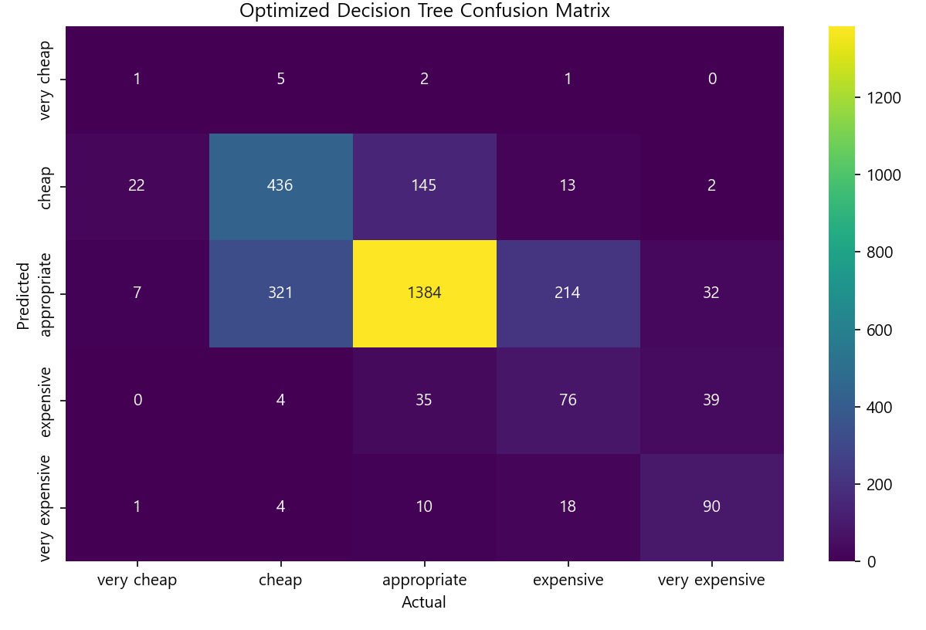

Slide 52
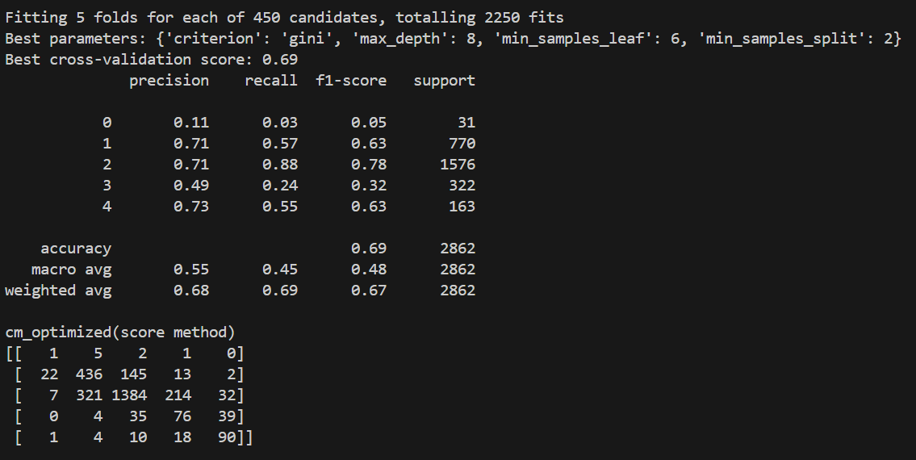

Slide 53
DecisionTree_score
Test_size = 0.3

Slide 54
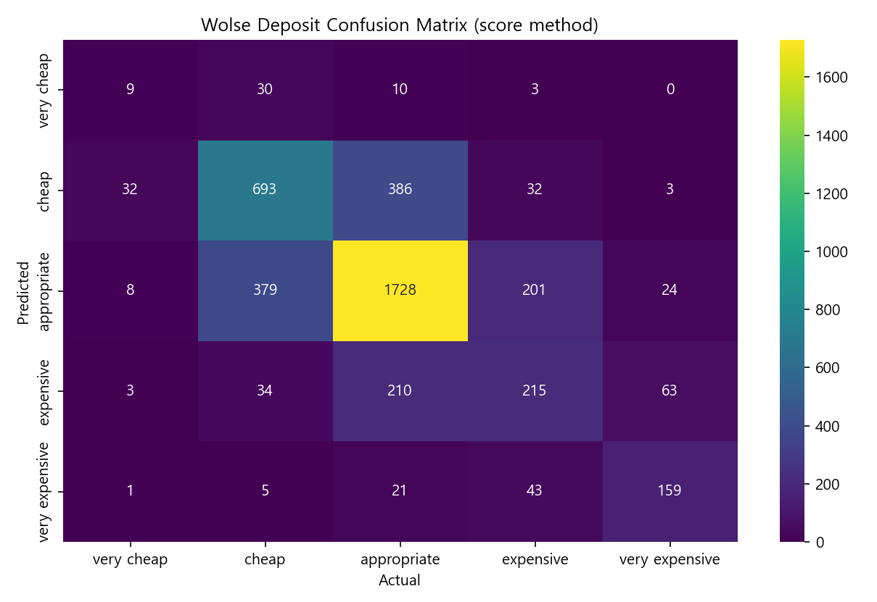

Slide 55
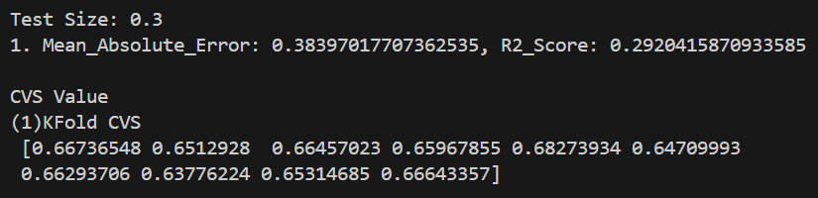

Slide 56
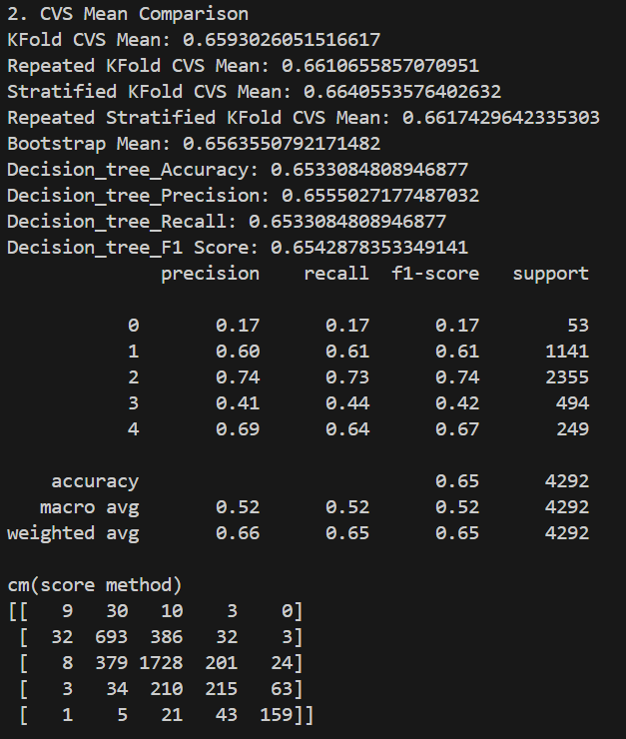

Slide 57
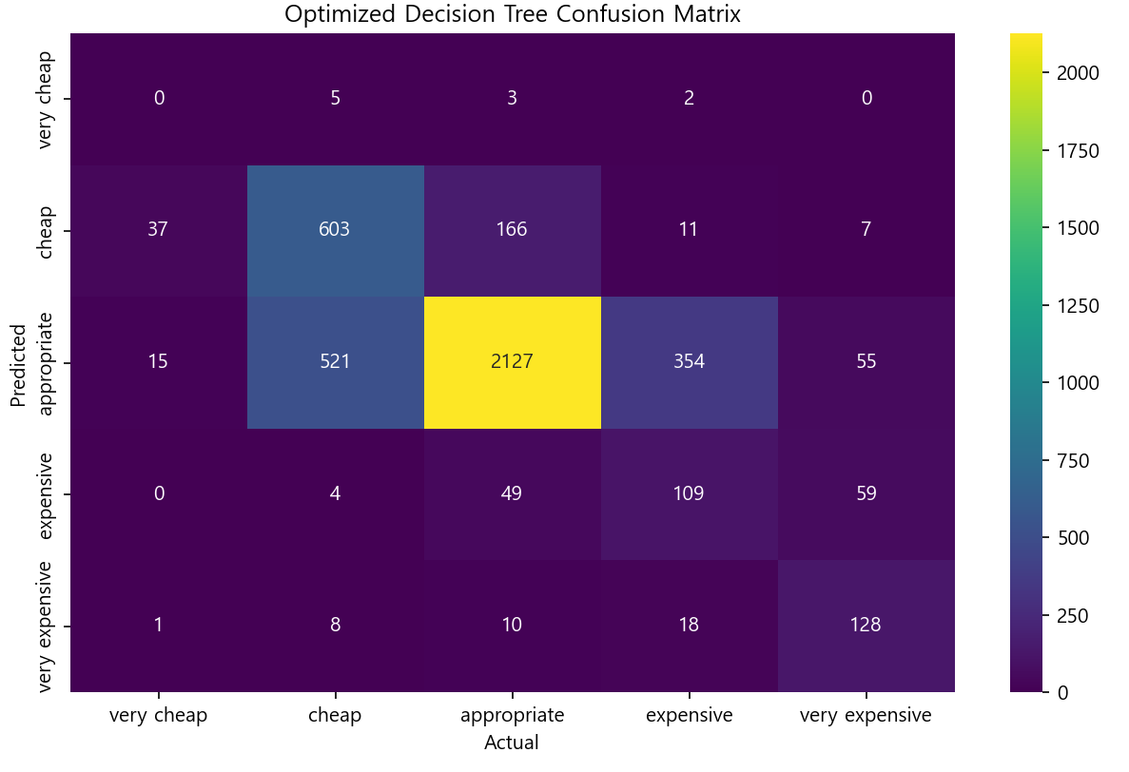

Slide 58
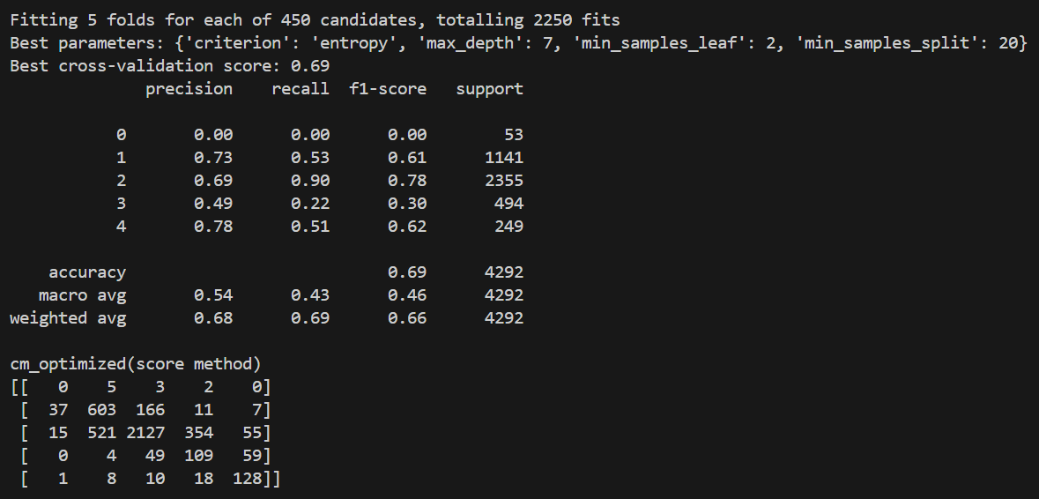

Slide 59
DecisionTree_score
Test_size = 0.4

Slide 60
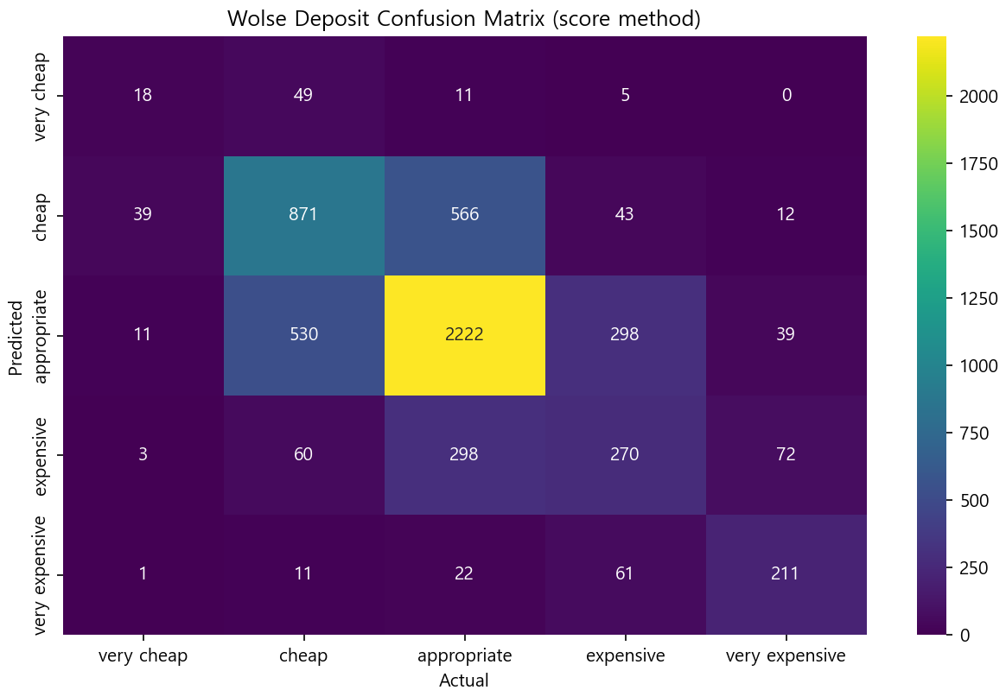

Slide 61
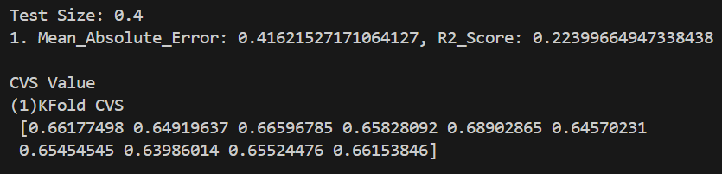

Slide 62
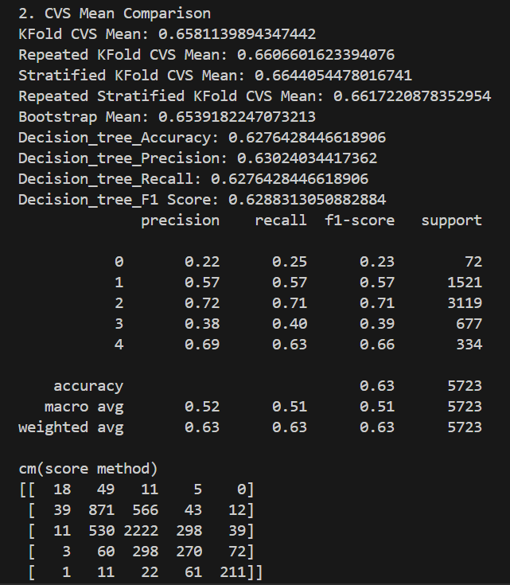

Slide 63
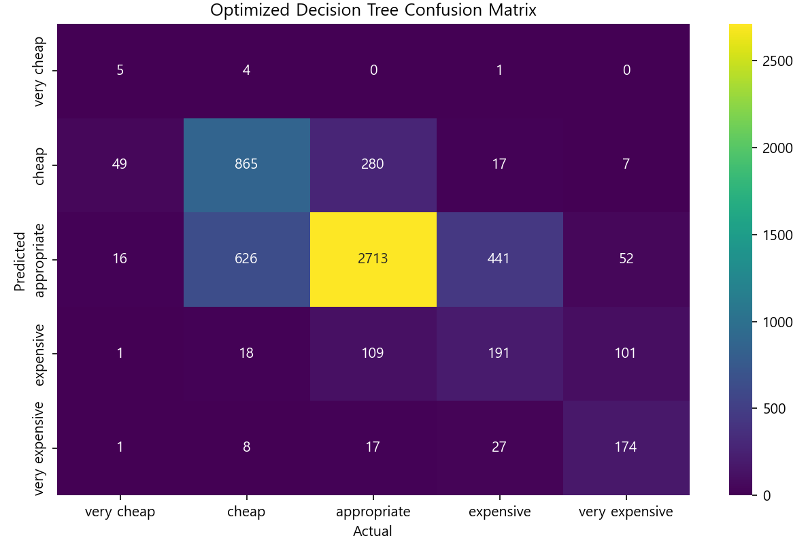

Slide 64
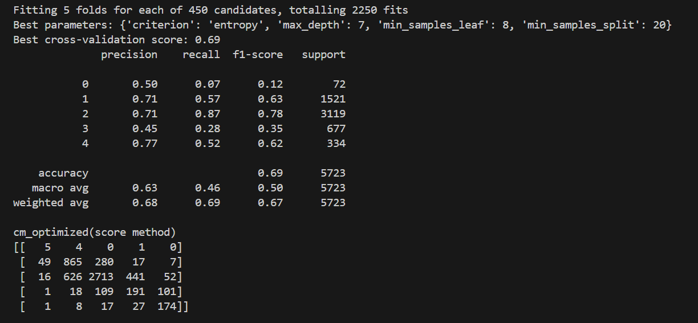

Slide 65
DecisionTree_score
Test_size = 0.5

Slide 66
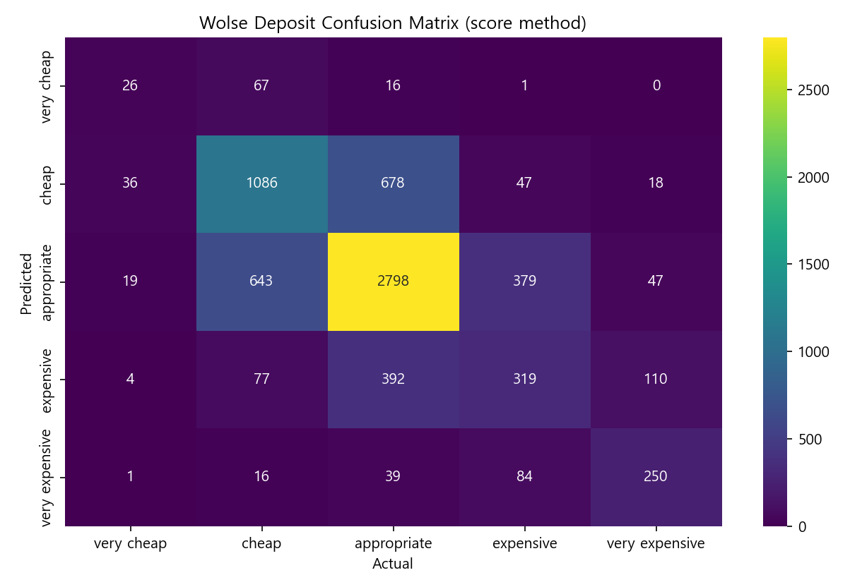

Slide 67
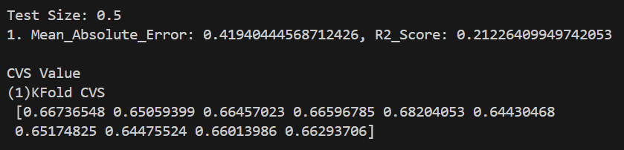

Slide 68
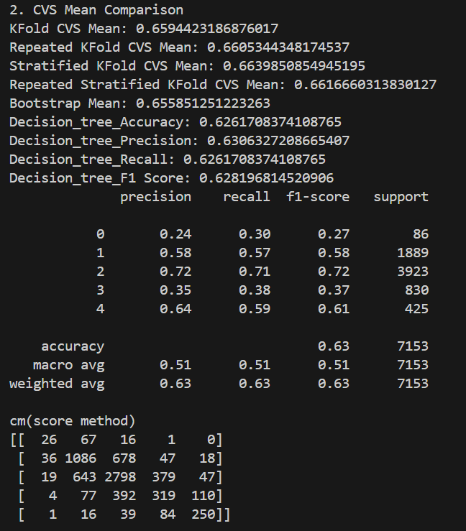

Slide 69
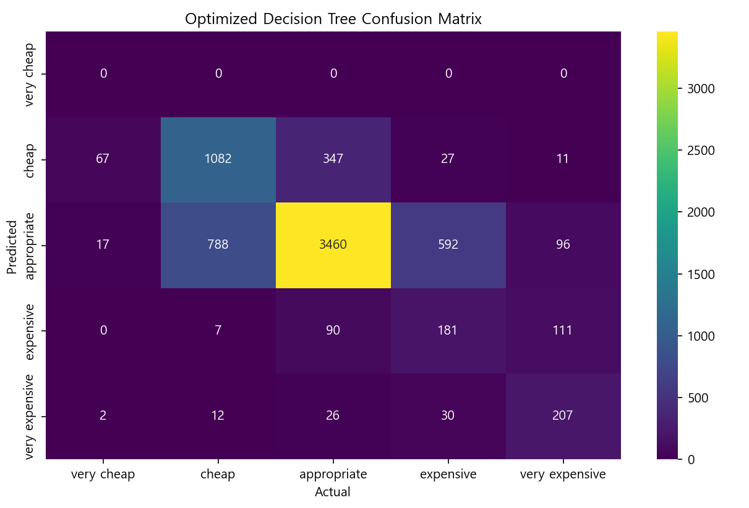

Slide 70


Slide 71
DecisionTree_one-hot
Test_size = 0.1

Slide 72


Slide 74


Slide 75


Slide 76


Slide 77
DecisionTree_one-hot
Test_size = 0.2

Slide 78


Slide 80


Slide 81


Slide 82


Slide 83
DecisionTree_one-hot
Test_size = 0.3

Slide 84


Slide 86


Slide 87


Slide 88


Slide 89
DecisionTree_one-hot
Test_size = 0.4

Slide 90


Slide 92


Slide 93


Slide 94


Slide 95
DecisionTree_one-hot
Test_size = 0.5

Slide 96


Slide 98


Slide 99


Slide 100


